Slide 1
SUSTAINABLE LOW COST TECHOLOGY FOR DEVELOPMENT OF FEMININE HYGIENE PRODUCTS
Dr Mona Suri
Academic Vice President
Royal University for Women, Kingdom of Bahrain

Slide 2
Research
Emphasis on research by women for women issues
Women empowerment
Environmental issues
Product Innovation
Academic- Community- Government collaboration

Slide 3
Concept of Design
Design is aesthetics + Functionality
Sustainable design (also called environmental design, environmentally sustainable design, environmentally conscious design, etc.) is the philosophy of designing physical objects, the built environment, and services to comply with the principles of social, economic, and ecological sustainability.

Slide 4
Overview of the study
Done in semi urban cities of India
Felt needs of the women belonging to lower SES were addressed
Intervention study to create innovation in design
Prototypes of Sanitary napkins were created
Classic example of technology transfer to the community
Empowerment of women by providing them with a solution and a business proposition

Slide 5
Low Cost Menstrual Hygiene Products
Limited literature on Menstrual Hygiene Management.
Needs more emphasis in the environment, water and sanitation programmes.
Research and Development efforts limited to commercial ventures in India thus unable to market products that are affordable by the poor.
Social marketing and franchising as used in marketing of Oral Rehydration Salts, campaigning against diseases

Slide 6
Methodology
Market survey of the availability of products
Development of the prototype
Evaluation of physical properties, hygiene properties and cost
Transfer of Technology to the community
Need Assessment of the use of feminine hygiene products

Slide 7
Need Assessment
Semi Urban areas were chosen
Working women of Lower SES
Sample of over 200 women was chosen through purposive sampling
Focused group discussions and Interviews were used as tools of data collection
Market survey of the available products was done
Data was analysed to identify the felt needs of the target group

Slide 8
Feminine Hygiene Products
Cost profile of the branded product suits the needs of only high end of the market
Need to develop a low cost sustainable indigenous technology
Cost can be brought down by
Recycling
Use of alternate material
Desirable properties of raw material
Natural fiber, Biodegradable, Very low cost
Options analyzed
Cotton Knitwear waste

Slide 9
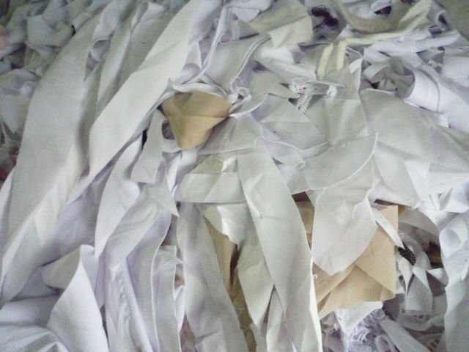
Use and availability of Knitwear waste
Tirupur Knitwear Industry in Tamilnadu is one of the
largest cotton garment manufacturing industry in India
10-20 % of the cotton knitwear is generated as a waste
Can be recycled to create more products
Need to process it effectively for product profile chosen
For Feminine hygiene products need to change of form,
maintain hygiene properties, develop low cost technology

Slide 10
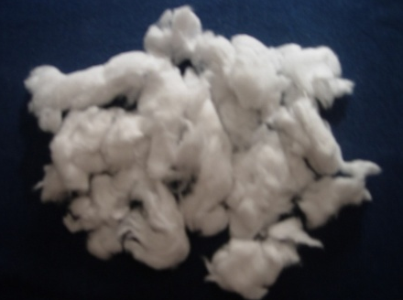
Raw Materials
Cotton
Highly absorbent, naturally breathing, cohesive and easily sterializable fiber
Not used due to high cost
Low cost cotton from knitwear waste
High value at low price

Slide 11
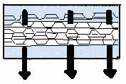
Sanitary Napkin – Technical Details
ABSORBENT LAYER
Wood-pulp, cotton linters, viscose
Absorbs & retains the liquid
Spreads fluid by capillary
action
TOP LAYER
Polypropylene,
Polyethylene
Porous Layer
Fluid is quickly drawn in
Allows Passage to
Liquids
BACK LAYER
Polyethylene
Non porous
Prevents leakage

Slide 12
Manufacture of Sanitary Napkins using Knitwear Waste
ABSORBENT LAYER
Cotton Knitwear Waste
Hydro
Drying of
Garneting
Washing
extraction
fiber
Lap formation
TOP LAYER
Cutting
PP Sheets
Cutting PP
Sealing of the laid web between the top & bottom layer
BACK LAYER
PE Sheets
Cutting PE
Sterilization(as per requirement)

Slide 13
Comparison of Branded and Developed Sanitary Napkins
Developed prototypes and 16 varieties of sanitary napkins of 4 major companies were evaluated using standard test methods in terms of:
Physical properties (pH, Flexibility, Water Retention, Disposability)
Hygiene Parameters (Bacterial and Fungal bioburden)
Cost

Slide 14
Physical Parameters of Cotton Knitwear Waste
Vs. Branded Napkins
Parameter | Branded sanitary napkin (regular) | Cotton Knitwear waste napkin
pH | 6.06 to 8.11 | 7.0
Absorbency time (seconds) | 4-30 | 15-20
Water retention (%) | 175 to 631 | 369
Flexibility (gms) | 1369 to 3601 | 1869
Disposability | < 5 minutes | < 5 minutes
Brightness (%) | 74 | 84

Slide 15
Hygiene Parameters of Cotton Knitwear Waste Vs. Prototype Branded Napkins
Napkin type | Aerobic Plate Count (c.f.u/ml) Colony Forming unit | Yeast and Mould Count (c.f.u/ml) Colony Forming unit
Branded sanitary napkins (Regular type) | 10 - 1660 | 0 - 730
Knitwear waste napkin- non sterile | 75 | 60
Sterile | 70 | 0

Slide 16
Limited Production Cost of Developed Prototypes
Cost of the beltless colored knitwear waste napkin = Approx. Re. 1
Cost of the beltless white knitwear waste napkin = Approx. Rs.1.10
Cost of the belted colored knitwear waste napkin = Approx. Rs.1.20
Cost of the belted white knitwear waste napkin = Approx. Rs.1.30
1 BHD= 175 Rupees (Cost of napkin 6-6.5 fills)

Slide 17
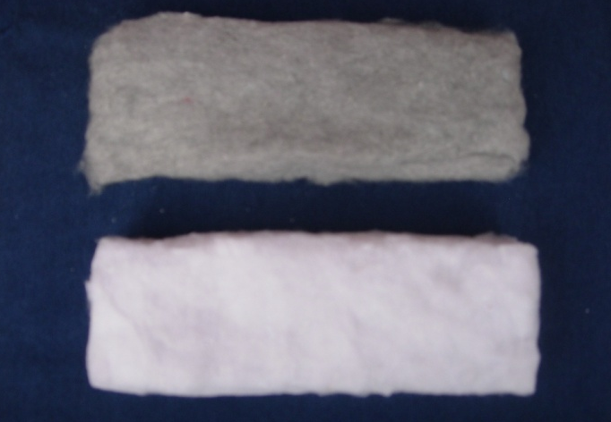
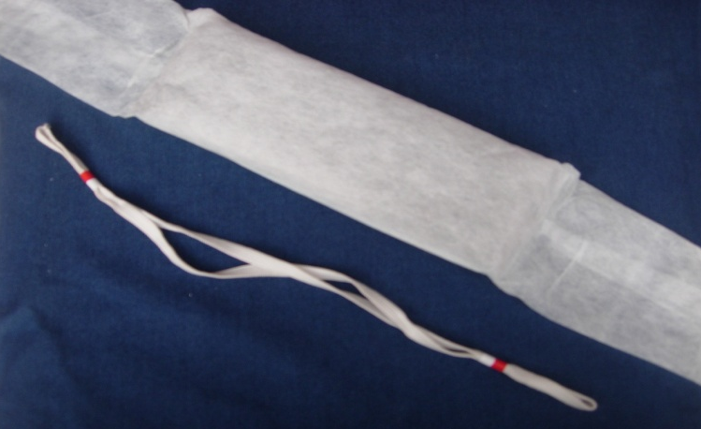
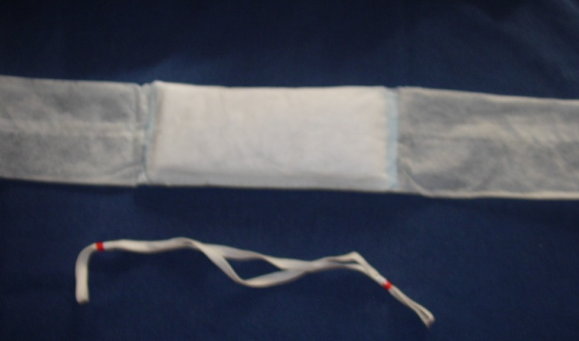
SANITARY NAPKIN DEVELOPMENT FROM KNITWEAR
WASTE FIBER
Belted Type Sanitary Napkins Using Knitwear Waste
Laps of colored and white cotton
knitwear waste fiber
B. Belted napkin in colored cotton knitwear waste
C. Belted napkin in white cotton knitwear waste
C. Belted napkin in white cotton knitwear waste

Slide 18
BELTLESS SANITARY NAPKINS USING KNITWEAR
WASTE FIBER
Belt Less Type Sanitary Napkins Using Knitwear Waste
B. In white cotton knitwear waste
A. In colored cotton knitwear waste
C. Backside of Napkin marked with color to differentiate size
C. Back of the napkin marked with different color lines for size variations

Slide 19
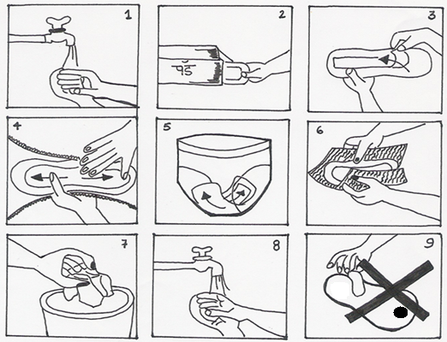
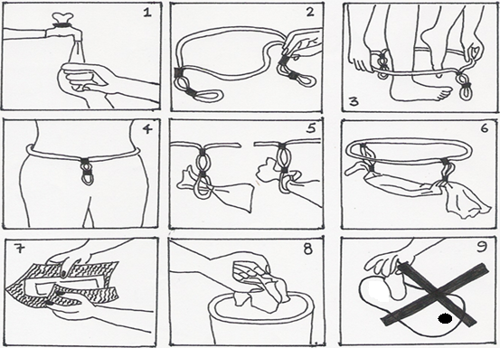
Transfer of technology to Community
The machines for Garneting, washing, Lap formation sealing, autoclave were sourced from small scale manufacturers
Assembly line was created for effective manufacturing
Packaging was done with Instruction sheets
The unit with machines could be set up in a room in any village or sub urban area
Total cost of machines was about 100, 000 Rupees (500 BHD)
Workshops were conducted for local women to train them for manufacturing, Packaging and selling
Distribution networks were created
Instruction sheet for Belt less napkins
Instruction sheet for Belted napkins

Slide 20
Conclusion
Low cost sanitary napkins can be developed using alternate materials like cotton knitwear waste and Bagasse pulp as the absorbent web.
Quality of the sanitary napkins thus made are comparable in quality to branded sanitary napkins in terms of various physical and hygiene parameters.
This will enable the women from the lower economic strata to use disposable sanitary napkins, thus ensuring improved status of menstrual hygiene.
The assembly line can easily be established in rural, semi urban areas and trainers trained to implement it as an entrepreneurial venture.
This fulfils the needs of women and society.

Slide 21
RUW’s initiatives towards Community based studies
Design and Development of Industrial Clothing for BAPCO Employees
At BAPCO the Protective Clothing is worn by the employees as per the norms
RUW approached the term design with functional utility and problem solving
Provided more options for special clothing/ uniforms for BAPCO employees
Male workers
Women employees (Present & Prospective)
Training of Bahraini Women in Fashion Design
Project was done in collaboration with the Supreme Council for Women and Tamkeen
60 Bahraini women were trained

Slide 22
Research emphasis
With Emphasis on research at RUW more such Intervention studies are being taken up to address the felt needs of the community
Design as a function is being emphasized upon
Traditional arts of Bahrain and the region are being documented and revived (Weaving arts, Naqda work)
Futuristically RUW would like to make a niche by doing such community based design studies

Slide 23
Thank you…

